Slide 1
America’s History Chapter 25- Early Cold War

Slide 2
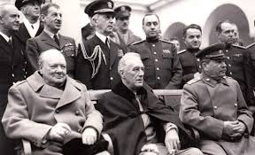
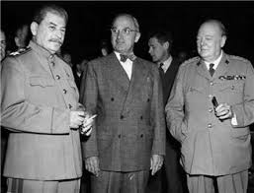
Containment and a Divided Global Order
Origins of the Cold War
Is the enemy of your enemy, your friend, or your enemy?
Yalta:
Last meeting of the “Big 3”
Stalin promised “free and unfettered elections” in Poland at a later date
Germany was divided into 4
United Nations (UN) was agreed upon
Potsdam:
Truman replaced FDR at the Potsdam Conference
Stalin did not allow self-determination in Eastern Europe
Churchill’s “Iron curtain” speech

Slide 3
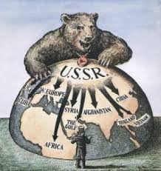
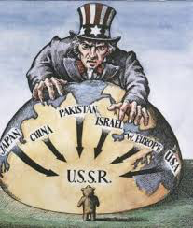
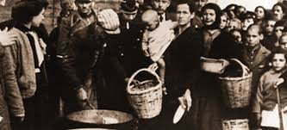
Containment and a Divided Global Order
The Containment Strategy
3 issues that concerned Truman:
Soviet Union wanted access to oil in Iran, and the Mediterranean through Turkey
Civil War in Greece - monarchists vs. communist party
Communist parties increased in popularity as the economy of Europe suffered

Slide 4
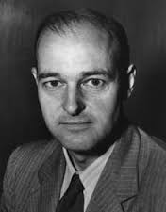
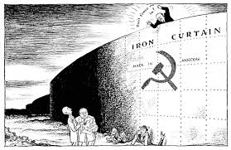
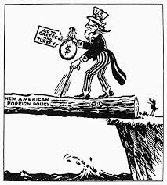
Containment and a Divided Global Order
Toward an Uneasy Peace:
**George F. Kennan** - urged the Containment of the Soviet Union through counterforce
Truman Doctrine - Provided $400 million in aid to Greece and Turkey to resist communism
Marshall Plan - $13 billion to help rebuild war-torn Europe; hoped to make communism less appealing in Europe
The Soviet Union rejected the aid and forbade Eastern European countries from receiving aid as well

Slide 5
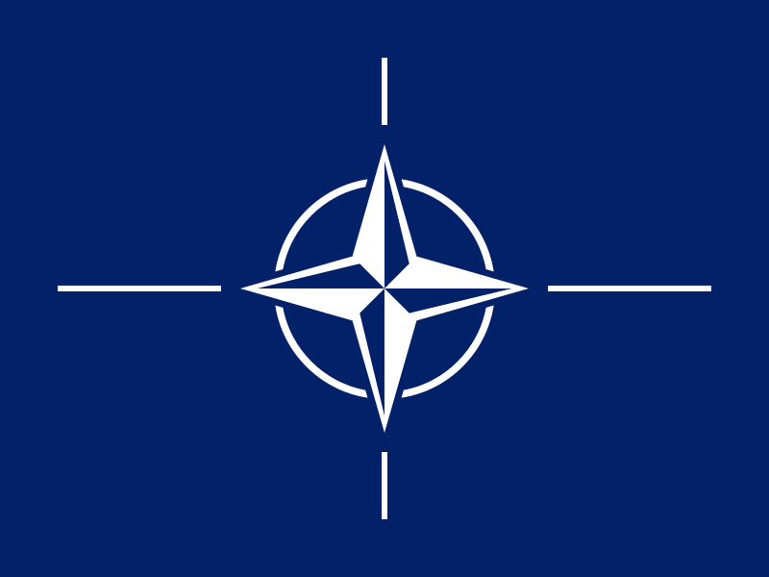
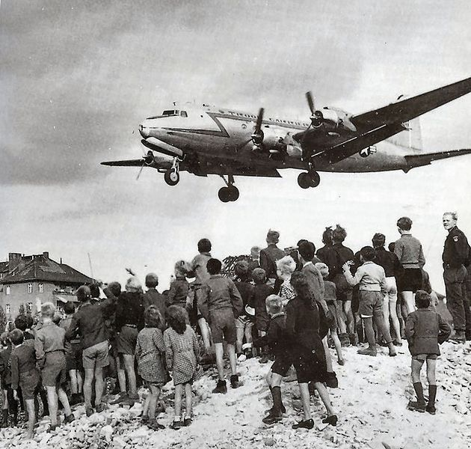
Containment and a Divided Global Order
The Containment Strategy
East and West in the New Europe:
Berlin Blockade (June, 1948) -> Berlin Airlift
North Atlantic Treaty Organization (NATO) - peace time alliance, “an attack on one is an attack on all”
The Soviet Union responded later with the Warsaw Pact
NSC-68:
Painted the USSR more starkly than Kennan
Led to a drastic buildup of the military

Slide 6
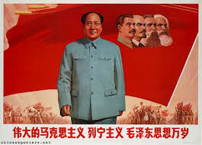
Containment and a Divided Global Order
Containment in Asia
Civil War in China:
Communists (Mao) vs. Nationalists (Jiang)
Truman eventually cut off aid to Jiang and Mao and the Communists took control
Truman was blamed for “losing” China

Slide 7
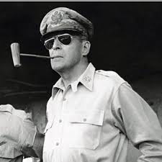
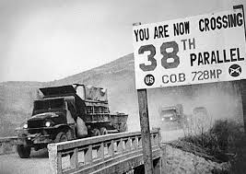
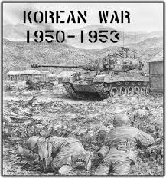
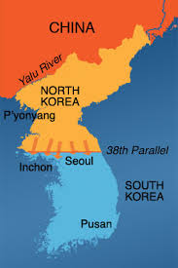
Containment and a Divided Global Order
The Korean War:
Korea was divided at the 38th parallel, USSR supported the North, US the South
North Korea attacked the South in June, 1952
Truman fired General MacArthur for criticizing the war
War fought without Congressional approval; desegregated units
The War ended with Eisenhower’s administration

Slide 8
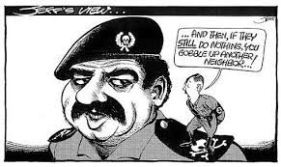
Containment and a Divided Global Order
The Munich Analogy:
Fear of “appeasing” Russian leaders was a powerful motive for US presidents

Slide 9
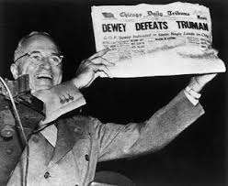
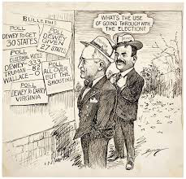
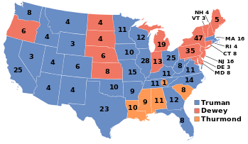
Cold War Liberalism
Truman and the End of Reform
Cold War Liberalism - preservation of New Deal programs, as well as a containment policy
Many union members went on strike post-WWII
Taft-Hartley Act - outlawed the “closed shop”, allowed right-to-work laws
Non-union members could work in union jobs
The 1948 Election:
The Democratic Party was split
“Dixiecrats” nominated Strom Thurmond on a segregationist platform
Harry Truman defeats Dewey in an upset

Slide 10
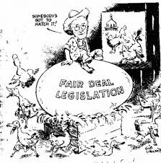
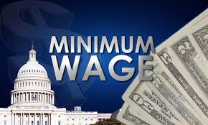
Cold War Liberalism
The Fair Deal:
Proposed national health insurance, money for education, increased Social Security, and raising the minimum wage
Most of his proposals were rejected

Slide 11
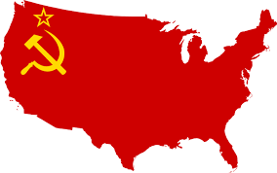
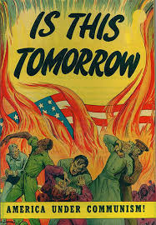
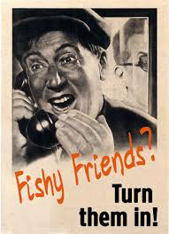
Cold War Liberalism
Red Scare: The Hunt for Communists
Some government employees and aides to FDR provided the Soviet Union with information
Loyalty-Security Program:
Executive Order 9835 - government employees could be investigated for subversive activity
HUAC:
House Un-American Activities Committee:
Richard Nixon was a prominent member
Held public hearings on suspected communists
“Hollywood Ten”
Alger Hiss - convicted of perjury, spent five years in jail

Slide 12
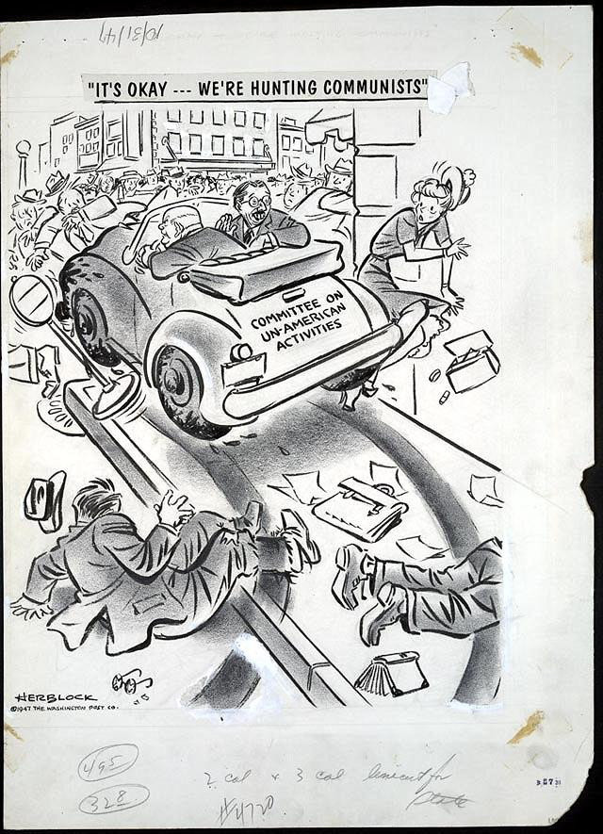
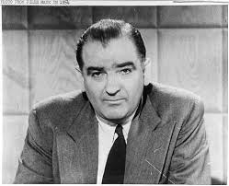
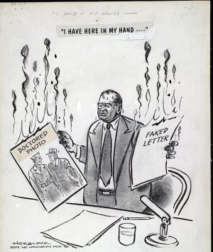
Cold War Liberalism
McCarthyism:
Accused over 200 government officials of being communist party members
His charges were often aimed at Democrats
McCarthy’s downfall came when he attacked the US military, seen as a bully

Slide 13
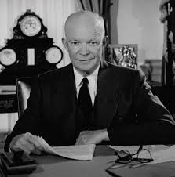
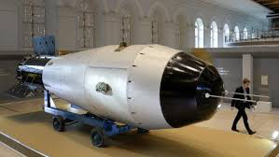
Cold War Liberalism
The Politics of Cold War Liberalism
“Modern Republicanism” - moderating New Deal programs
Eisenhower was a moderate
America Under Eisenhower:
“New Look” defense policy - increased military buildup (hydrogen bomb, bombers)
Massive Retaliation - US would respond with more force if attacked

Slide 14
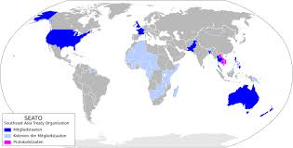
Containment in the Postcolonial World
Revolutions in Third World countries were often regarded as pawns of the Soviet Union
The Cold War and Colonial Independence
Southeast Asia Treaty Organization (SEATO) - Asian NATO
Truman and Eisenhower sometimes supported repressive governments, as long as they were anticommunist
CIA overthrew Mohammad Mossadegh that was elected in Iran, and Jacob Arbenz Guzman in Guatemala

Slide 15
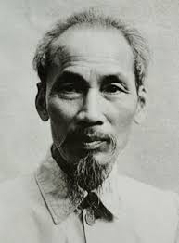
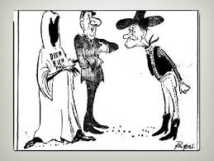
Containment in the Postcolonial World
Vietnam:
Vietnam was once a French colony
Ho Chi Minh, a communist, sought to unite Vietnam
Dien Bien Phu - French defeat in 1954, left Vietnam, US increased its presence

Slide 16
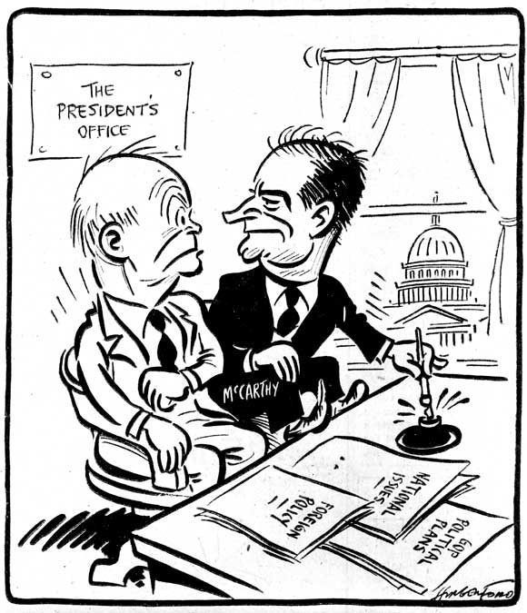
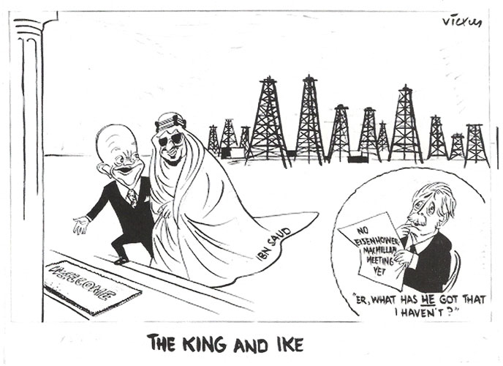
Containment in the Postcolonial World
The Middle East:
US recognized Israel almost immediately
Egyptian President Nasser nationalized the Suez Canal, Britain and France attacked, Eisenhower helped end the conflict
Eisenhower Doctrine - US would help countries in the Middle East that resisted communism

Slide 17
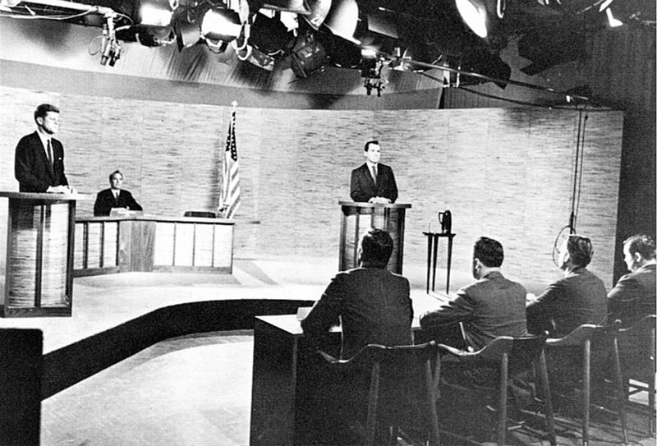
Containment in the Postcolonial World
John F. Kennedy and the Cold War
The Election of 1960 and the New Frontier:
1960 debates - JFK “won” to those that watched on tv, Nixon “won” to those that listened
JFK won in a close election
“New Frontier” - called for advancements in science and Americans to achieve their fullest

Slide 18
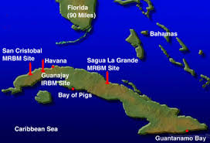
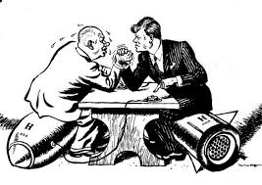
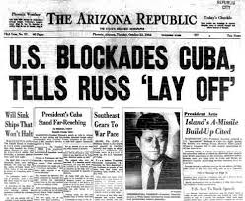
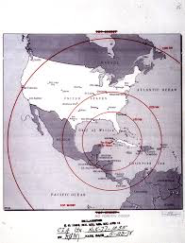
Containment in the Postcolonial World
Crisis in Cuba and Berlin:
Fidel Castro overthrew Batista in 1959
Bay of Pigs - CIA operation to try to overthrow Castro in 1961, huge failure
Khrushchev began construction of the Berlin Wall in 1961 to keep East Berliners from fleeing
October, 1962 - Cuban Missile Crisis - closest the two sides came to war
US agreed to remove missiles from Turkey, USSR promised to remove missiles from Cuba

Slide 19
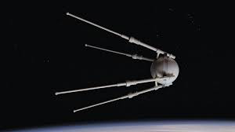
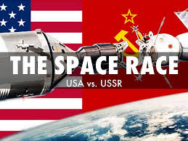
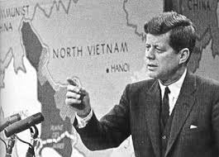
Containment in the Postcolonial World
Kennedy and the World:
Peace Corps - 2 year commitment by Americans to volunteer in third world regions
Teaching, social, and economic development
Hoped to promote America and democracy
1957 - Sputnik and April 12, 1961 - Yuri Gagarin
Led to increased spending by US government on science and education
Making a Commitment in Vietnam
JFK increased military aid to South Vietnam
Special forces trained South Vietnamese troops
South Vietnam was led by Diem, a corrupt leader

Slide 20
The Recap
Truman Doctrine and Marshall Plan
Berlin Airlift
NATO
Korean War
1948 Election
McCarthyism and the 2nd Red Scare
The Cold War and Eisenhower
The Election of 1960
Cuba

